Slide 1
UNIT-5
PHP and MYSQL
PHP Basics - Arrays - Functions- Form Handling - File handling - Date and Time - MYSQL Basics - PHP and MYSQL Database Connectivity- Session - Cookies, E-mail - PHP and XML -PHP and AJAX.

Slide 2
PHP Introduction
PHP was created by Rasmus Lerdorf in 1994 but appeared in the market in 1995.
PHP is a server-side scripting language
PHP scripts are executed on the server
PHP supports many databases (MySQL, Informix, Oracle, Sybase, Solid, PostgreSQL, Generic ODBC, etc.)‏
PHP is open source software
PHP is free to download and use

Slide 3
PHP Introduction
PHP runs on different platforms (Windows, Linux, Unix, etc.)‏
PHP is compatible with almost all servers used today (Apache, IIS, etc.)‏
PHP is FREE to download from the official PHP resource: www.php.net
PHP is easy to learn and runs efficiently on the server side.
PHP supports several protocols such as HTTP, POP3, SNMP, LDAP, IMAP, and many more.

Slide 4
PHP Introduction
Instead of lots of commands to output HTML (as seen in C or Perl), PHP pages contain HTML with embedded code that does "something" (like in the next slide, it outputs "Hi, I'm a PHP script!").
The PHP code is enclosed in special start and end processing instructions <?php and ?> that allow you to jump into and out of "PHP mode.“
PHP can handle the forms, such as - collect the data from users using forms, save it into the database, and return useful information to the user. For example - Registration form.

Slide 5
PHP Features
Performance
Open Source
Embedded
Control
Loosely Typed Language
Security
Helpful PHP Community
Web Server Support
Error Reporting
Platform Independent
Familiarity with syntax

Slide 6
Install PHP
WAMP- Windows-https://www.wampserver.com/en/
LAMP- Linux-http://csg.sph.umich.edu/abecasis/LAMP/download/
MAMP- Mac-https://www.mamp.info/en/downloads/
XAMPP- Apache, MySQL, PHP, Perl
-https://www.apachefriends.org/download.html

Slide 7
PHP Introduction
<html>
<body>
<?php
echo "<h2>Hello First PHP</h2>";
?>
</body>
</html>

Slide 8
PHP Hello World
This program is extremely simple and you really did not need to use PHP to create a page like this. All it does is display: Hello World using the PHP echo() statement.
Think of this as a normal HTML file which happens to have a set of special tags available to you that do a lot of interesting things.

Slide 9
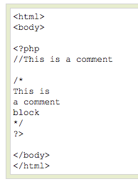
PHP Comments
In PHP, we use // to make a single-line comment or /* and */ to make a large comment block.

Slide 10
PHP Variables
<!DOCTYPE html>
<html>
<body>
<?php
$txt = "University";
echo "VIT Bhopal $txt!";
?>
</body>
</html>
In PHP, a variable starts with the $ sign, followed by the name of the variable:

Slide 11
PHP Math
<?php
echo(min(0, 150, 30, 20, -8, -200)); // returns -200
echo(max(0, 150, 30, 20, -8, -200)); // returns 150
?>
The min() and max() functions can be used to find the lowest or highest value in a list of arguments:

Slide 12
PHP Constant Arrays
<?php
define(“Branch”, [
“AI”,
“ML",
“CI”
]);
?>
An Array constant using the define() function

Slide 13
PHP Arrays
<!DOCTYPE html>
<html>
<body>
<?php
$cars = array("Volvo", "BMW", "Toyota");
echo "I like " . $cars[0] . ", " . $cars[1] . " and " . $cars[2] . ".";
?>
</body>
</html>
Indexed arrays - Arrays with a numeric index
Associative arrays - Arrays with named keys
Multidimensional arrays - Arrays containing one or more arrays

Slide 14
PHP Arrays
$cars = array (
array("Volvo",22,18),
array("BMW",15,13),
array("Saab",5,2),
array("Land Rover",17,15)
);
Indexed arrays – $cars[0] = “AI";
$cars[1] = “ML";
$cars[2] = “CI";
Associative arrays –$age[‘Abhinav'] = "35";
$age[‘Rishav'] = "37";
$age[‘Shanu'] = "43";
Multidimensional arrays -

Slide 15
What is a PHP File?
1.PHP files can contain text, HTML, CSS, JavaScript, and PHP code
2. PHP code are executed on the server, and the result is returned to the browser as plain HTML
3. PHP files have extension ".php"

Slide 16
What Can PHP Do?
PHP can generate dynamic page content
PHP can create, open, read, write, delete, and close files on the server
PHP can collect form data
PHP can send and receive cookies
PHP can add, delete, modify data in your database
PHP can encrypt data

Slide 17
Why PHP?
PHP runs on various platforms (Windows, Linux, Unix, Mac OS X, etc.)
PHP is compatible with almost all servers used today (Apache, IIS, etc.)
PHP supports a wide range of databases
PHP is free. Download it from the official PHP resource: www.php.net
PHP is easy to learn and runs efficiently on the server side

Slide 18
To start using PHP, you can:
Find a web host with PHP and MySQL support
Install a web server on your own PC, and then install PHP and MySQL
Use a Web Host with PHP Support
If your server has activated support for PHP you do not need to do anything.
Just create some .php files, place them in your web directory, and the server will automatically parse them for you.
You do not need to compile anything or install any extra tools.
Because PHP is free, most web hosts offer PHP support.
Set Up PHP on Your Own PC

Slide 19
However, if your server does not support PHP, you must:
install a web server
install PHP
install a database, such as MySQL

Slide 20
Data Types
Variables can store data of different types, and different data types can do different things.
PHP supports the following data types:
String
Integer
Float (floating point numbers - also called double)
Boolean
Array
Object
NULL
Resource

Slide 21
PHP String
A string is a sequence of characters, like "Hello world!".
A string can be any text inside quotes. You can use single or double quotes:
Example
<html>
<body>
<?php
$x = "Hello world!";
$y = 'Hello world!'; echo $x; echo "<br>"; echo $y;
?>
</body>
</html>
OUTPUT:
Hello world! Hello world!

Slide 22
String Functions
Get The Length of a String
The PHP streln() function returns the length of a string.
The example below returns the length of the string "Hello world!"
<html>
<body>
<?php echo strlen("Hello world!"); ?>
</body>
</html>
OUTPUT:
12
str_word_count()
strrev()
str_replace()

Slide 23
PHP Integer
An integer data type is a non-decimal number
Rules for integers:
An integer must have at least one digit
An integer must not have a decimal point
An integer can be either positive or negative
Integers can be specified in three formats: decimal (10-based), hexadecimal (16- based - prefixed with 0x) or octal (8-based - prefixed with 0)
In the following example $x is an integer.

Slide 24
The PHP var_dump() function returns the data type and value:
<html>
<body>
<?php
$x = 5985; var_dump($x);
?>
</body>
</html>
OUTPUT: int(5985)

Slide 25
PHP Float
A float (floating point number) is a number with a decimal point or a number in exponential form.
In the following example $x is a float. The PHP var_dump() function returns the data type and value:

Slide 26
PHP Float
<html>
<body>
<?php
$x = 5985.55; var_dump($x);
?>
</body>
</html>
OUTPUT: float(5985.55)

Slide 27
PHP Boolean
A Boolean represents two possible states: TRUE or FALSE.
$x = true;
$y = false;

Slide 28
PHP Array
An array stores multiple values in one single variable:
An array is a special variable, which can hold more than one value at a time.
If you have a list of items (a list of car names, for example), storing the cars in single variables could look like this:
$cars1 = "Volvo";
$cars2 = "BMW";
$cars3 = "Toyota";
However, what if you want to loop through the cars and find a specific one? And what if you had not 3 cars, but 300?
The solution is to create an array!
An array can hold many values under a single name, and you can access the values by referring to an index number.

Slide 29
<html>
<body>
<?php
$cars = array("Volvo", "BMW", "Toyota"); echo "I like " . $cars[0] . ", " . $cars[1] . " and " . $cars[2] . ".";
?>
</body>
</html>
OUTPUT:
I like Volvo, BMW and Toyota.

Slide 30
Create an Array in PHP
In PHP, the array() function is used to create an array: array();
In PHP, there are three types of arrays:
Indexed arrays - Arrays with a numeric index
Associative arrays - Arrays with named keys
Multidimensional arrays - Arrays containing one or more arrays

Slide 31
• rsort() - sort arrays in descending order
• asort() - sort associative arrays in ascending order, according to the value
• ksort() - sort associative arrays in ascending order, according to the key
• arsort() - sort associative arrays in descending order, according to the value
• krsort() - sort associative arrays in descending order, according to the key

Slide 32
Rules for PHP variables:
A variable can have a short name (like x and y) or a more descriptive name (age, carname, total_volume).
A variable starts with the $ sign, followed by the name of the variable.
A variable name must start with a letter or the underscore character.
A variable name cannot start with a number
A variable name can only contain alpha-numeric characters and underscores (A- z, 0-9, and _ ).
Variable names are case-sensitive ($age and $AGE are two different variables)

Slide 33
PHP Variables Scope
In PHP, variables can be declared anywhere in the script.
The scope of a variable is the part of the script where the variable can be referenced/used.
PHP has three different variable scopes: local global static
Global and Local Scope
A variable declared outside a function has a GLOBAL SCOPE and can only be accessed outside a function:

Slide 34
<html>
<body>
<?php
$x = 5; // global scope function myTest() {
// using x inside this function will generate an error echo "<p>Variable x inside function is: $x</p>";
} myTest(); echo "<p>Variable x outside function is:
$x</p>"; ?>
</body>
</html>
OUTPUT:
Variable x inside function is:
Variable x outside function is: 5

Slide 35
<html>
<body>
<?php function myTest() {
$x = 5; // local scope echo "<p>Variable x inside function is: $x</p>";
} myTest();
// using x outside the function will generate an error echo "<p>Variable x outside function is:
$x</p>"; ?>
</body>
</html>
OUTPUT:
Variable x inside function is: 5 Variable x outside function is:

Slide 36
The global Keyword
<html>
<body>
<?php
$x = 5;
$y = 10 function myTest() { global $x, $y;
$y = $x + $y;
} myTest(); // run function echo $y; // output the new value for variable $y
?>
</body>
</html>

Slide 37
The static Keyword
Normally, when a function is completed/executed, all of its variables are deleted. However, sometimes we want a local variable NOT to be deleted. We need it for a further job.
<html>
<body>
<?php function myTest() { static $x = 0; echo $x;
$x++;
} myTest(); echo "<br>"; myTest(); echo "<br>"; myTest();
?>
</body>
</html>
Output:
0
1
2

Slide 38
echo and print Statements
In PHP there are two basic ways to get output: echo and print.
In this, we use echo (and print) in almost every example.
The differences are small: echo has no return value while print has a return value of 1 so it can be used in expressions.
echo can take multiple parameters (although such usage is rare) while print can take one argument. echo is marginally faster than print.

Slide 39
PHP Object
An object is a data type which stores data and information on how to process that data.
In PHP, an object must be explicitly declared.
First we must declare a class of object. For this, we use the class keyword.
A class is a structure that can contain properties and methods:

Slide 40
PHP NULL Value
Null is a special data type which can have only one value: NULL.
A variable of data type NULL is a variable that has no value assigned to it.
If a variable is created without a value, it is automatically assigned a value of NULL.
Variables can also be emptied by setting the value to NULL:

Slide 41
PHP Operators
Operators are used to perform operations on variables and values.
PHP divides the operators in the following groups:
Arithmetic operators
Assignment operators
Comparison operators
Increment/Decrement operators
Logical operators
String operators
Array operators
== | Equality
=== | Identity
!= | Inequality
<> | Inequality
!== | Non- identity
++$x
$x++
--$x
$x--

Slide 42
PHP Conditional Statements
•if statement - executes some code if one condition is true
• if...else statement - executes some code if a condition is true and another code if that condition is false
• if...elseif....else statement - executes different codes for more than two conditions
• switch statement - selects one of many blocks of code to be executed

Slide 43
if statement - executes some code if one condition is true if (condition) { code to be executed if condition is true;
}
The example below will output "Have a good day!" if the current time (HOUR) is less than 20:
<html>
<body>
<?php
$t = date("H"); if ($t < "20") { echo "Have a good day!";
}
?>
</body>
</html>
OUTPUT:
Have a good day!

Slide 44
The if...else Statement
Syntax if (condition) { code to be executed if condition is true;
} else { code to be executed if condition is false;
}
The example below will output "Have a good day!" if the current time is less than 20, and "Have a good night!" otherwise:

Slide 45
<html>
<body>
<?php
$t = date("H"); if ($t < "20") { echo "Have a good day!";
} else { echo "Have a good night!";
}
?>
</body>
</html>
OUTPUT:
Have a good day!

Slide 46
The if...elseif...else Statement
if (condition) {
code to be executed if this condition is true;
} elseif (condition) {
code to be executed if this condition is true;
} else {
code to be executed if all conditions are false;
}

Slide 47
<html>
<body>
<?php
$t = date("H");
echo "<p>The hour (of the server) is " . $t;
echo ", and will give the
following message:</p>";
if ($t < "10") {
echo "Have a good morning!";
} elseif ($t < "20") {
echo "Have a good day!";
} else {
echo "Have a good night!";
}
?>
</body>
</html>
OUTPUT:
Have a good morning!

Slide 48
The switch Statement
The switch statement is used to perform different actions based on different conditions.
<html>
<body>
<?php
$favcolor = "red"; switch ($favcolor) { case "red": echo "Your favorite color is red!"; break; case "blue": echo "Your favorite color is blue!"; break; case "green": echo "Your favorite color is green!"; break; default: echo "Your favorite color is neither red, blue, nor green!";
}
?>
</body>
</html>
OUTPUT:
Your favorite color is red!

Slide 49
PHP Loops
•while- loops through a block of code as long as the specified condition is true
• do...while - loops through a block of code once, and then repeats the loop as long as the specified condition is true
• for- loops through a block of code a specified number of times
• foreach- loops through a block of code for each element in an array

Slide 50
PHP Loops
The PHP while Loop
<html>
<body>
<?php
$x = 1; while($x <= 5) { echo "The number is: $x
<br>"; $x++;
}
?>
</body>
</html>
OUTPUT:
The number is: 1 The number is: 2 The number is: 3 The number is: 4 The number is: 5

Slide 51
The PHP do...while Loop
<html>
<body>
<?php
$x = 1; do { echo "The number is: $x <br>";
$x++;
} while ($x <= 5); ?>
</body>
</html>
OUTPUT:
The number is: 1 The number is: 2 The number is: 3 The number is: 4 The number is: 5

Slide 52
The PHP for Loop
The for loop is used when you know in advance how many times the script should run.
Syntax for (init counter; test counter; increment counter) { code to be executed;
}
Parameters: init counter: Initialize the loop counter value test counter: Evaluated for each loop iteration. If it evaluates to TRUE, the loop continues. If it evaluates to FALSE, the loop ends. increment counter: Increases the loop counter value

Slide 53
<html>
<body>
<?php for ($x = 0; $x <= 10; $x++) { echo "The number is: $x <br>";
}
?>
</body>
</html>
OUTPUT:
The number is: 0 The number is: 1 The number is: 2 The number is: 3 The number is: 4 The number is: 5 The number is: 6 The number is: 7 The number is: 8 The number is: 9 The number is: 10

Slide 54
The PHP foreach Loop
The foreach loop works only on arrays, and is used to loop through each key/value pair in an array.
Syntax foreach ($array as $value)
{ code to be executed;
}
For every loop iteration, the value of the current array element is assigned to
$value and the array pointer is moved by one, until it reaches the last array element.
The following example demonstrates a loop that will output the values of the given array ($colors):

Slide 55
<html>
<body>
<?php
$colors = array("red", "green", "blue", "yellow"); foreach ($colors as $value)
{ echo "$value <br>";
}
?>
</body>
</html>
OUTPUT: red green blue yellow

Slide 56
Functions
• The real power of PHP comes from its functions; it has more than 1000 built-in functions.
PHP User Defined Functions
• Besides the built-in PHP functions, we can create our own functions.
• A function is a block of statements that can be used repeatedly in a program.
• A function will not execute immediately when a page loads.
• A function will be executed by a call to the function.

Slide 57
Create a User Defined Function in PHP
A user-defined function declaration starts with the word function:
Syntax function functionName() { code to be executed;
}

Slide 58
<html>
<body>
<?php function writeMsg(){ echo "Hello world!";
} writeMsg();
?>
</body>
</html>
OUTPUT:
Hello world!

Slide 59
PHP Function Arguments
• Information can be passed to functions through arguments. An argument is just like a variable.
• Arguments are specified after the function name, inside the parentheses. You can add as many arguments as you want, just separate them with a comma.
<html>
<body>
<?php function familyName($fname) { echo "$fname Refsnes.<br>";
} familyName("Jani"); familyName("Hege"); familyName("Stale"); familyName("Kai Jim"); familyName("Borge");
?>
</body>
</html>

Slide 60
PHP Return Value
<html>
<body>
<?php function sum($x, $y) {
$z = $x + $y; return $z;
} echo "5 + 10 = " . sum(5,10) . "<br>"; echo "7 + 13 = " . sum(7,13) . "<br>"; echo "2 + 4 = " . sum(2,4);
?>
</body>
</html>
OUTPUT:
5 + 10 = 15

Slide 61
File handling
It is an important part of any web application. You often need to open and process a file for different tasks.
PHP Manipulating Files
PHP has several functions for creating, reading, uploading, and editing files.
1. The readfile() function is useful if all you want to do is open up a file and read its contents.
2. A better method to open files is with the fopen() function. This function gives you more options than the readfile() function.
3. PHP Read Single Character - fgetc()

Slide 62

<?php
$myfile = fopen("any.txt", "r") or die("Unable to open file!"); echo fread($myfile,filesize("any.txt")); fclose($myfile);
?>

Slide 63
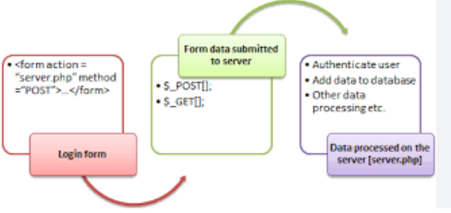
PHP Form Handling
The PHP superglobals $_GET and $_POST are used to collect form-data.
<html>
<body>
<form action="welcome.php" method="post">
Name: <input type="text" name="name"><br>
E-mail: <input type="text" name="email"><br>
<input type="submit">
</form>
</body>
</html> GET may be used for sending non-sensitive data.

Slide 64
PHP Date and Time
date(format,timestamp)
<?php
echo "Today is " . date("Y/m/d") . "<br>"; O/P=
echo "Today is " . date("Y.m.d") . "<br>";
echo "Today is " . date("Y-m-d") . "<br>";
echo "Today is " . date("l");
?>
Today is 2025/09/25
Today is 2025.09.25
Today is 2025-09-25
Today is Thursday

Slide 65
<html>
<body>
© 2020-<?php echo date("Y");?>
</body>
</html> O/P=© 2020-2024
<html>
<body>
<?php echo "The time is " . date("h:i:sa");
?>
</body>
</html> O/P = The time is 11:51:05am

Slide 66
1.Demonstrate the need for PHD and PHP features with neat sketch in details. Implement an online quiz application using PHP where the questions and answers are maintained in database.
2.Classify the types of Array in PHP with suitable example. Implement an employee details like name, ID, dept, gender and salary using PHP Associative Arrays with output.
3.Implement a Library management details to check whether the user return the book correct date or check the fine using PHP functions with output.

Slide 67
4.Differentiate Get and post method. Implement the event registration using PHP Form Handling operations with Get and post method with suitable output.
5.Describe the file handling functions and file modes in details. Implement the PHP File handling operations like file open, read, write and close with output.
6.Identify the need for Date and Time in PHP with suitable example.

Slide 68
PHP MySQL Database
• With PHP, you can connect to and manipulate databases.
• MySQL is the most popular database system used with PHP.
What is MySQL?
• MySQL is a database system used on the web
• MySQL is a database system that runs on a server
• MySQL is ideal for both small and large applications
• MySQL is very fast, reliable, and easy to use
• MySQL uses standard SQL
• MySQL compiles on a number of platforms
• MySQL is free to download and use
• MySQL is developed, distributed, and supported by Oracle Corporation

Slide 69
MySQLi extension (the "i" stands for improved)
• PDO (PHP Data Objects)
Both MySQLi and PDO have their advantages:
• PDO will work on 12 different database systems, whereas MySQLi will only work with MySQL databases.
• So, if you have to switch your project to use another database, PDO makes the process easy. You only have to change the connection string and a few queries. With MySQLi, you will need to rewrite the entire code - queries included.
• Both are object-oriented, but MySQLi also offers a procedural API.
MySQLi Installation
•For Linux and Windows: The MySQLi extension is automatically installed in most cases, when php5 mysql package is installed.
• For installation details, go to: http://php.net/manual/en/mysqli.installation.php
PDO Installation
• For installation details, go to: http://php.net/manual/en/pdo.installation.php

Slide 70
Open a Connection to MySQL
• Before we can access data in the MySQL database, we need to be able to connect to the server:
<?php
$servername = "localhost";
$username = "username";
$password = "password";
$conn = new mysqli($servername, $username, $password); if ($conn->connect_error) { die("Connection failed: " . $conn->connect_error);
} echo "Connected successfully"; ?>
<?php
$servername = "localhost";
$username = "username";
$password = "password";
$conn = mysqli_connect($servername, $username, $password);
// Check connection if (!$conn) { die("Connection failed: " . mysqli_connect_error());
} echo "Connected successfully"; ?>

Slide 71
Close the Connection
The connection will be closed automatically when the script ends.
To close the connection before, use the following:
1. MySQLi Object-Oriented
$conn->close();
2. MySQLi Procedural mysqli_close($conn);
3. PDO
$conn = null;

Slide 72
PHP Create a MySQL Database
• A database consists of one or more tables.
• You will need special CREATE privileges to create or to delete a MySQL database.
• Create a MySQL Database Using MySQLi
• The CREATE DATABASE statement is used to create a database in MySQL.
• The following examples create a database named "myDB":

Slide 73
PHP Insert Data Into MySQL
•Insert Data Into MySQL Using MySQLi
• After a database and a table have been created, we can start adding data in them.
Here are some syntax rules to follow:
• The SQL query must be quoted in PHP
• String values inside the SQL query must be quoted
• Numeric values must not be quoted
• The word NULL must not be quoted
The INSERT INTO statement is used to add new records to a MySQL table:
INSERT INTO table_name (column1, column2, column3,...) VALUES (value1, value2, value3,...)

Slide 74
Example (MySQLi Object-oriented)
<?php
$servername = "localhost";
$username = "username";
$password = "password";
$dbname = "myDB";
// Create connection
$conn = new mysqli($servername, $username, $password,
$dbname); // Check connection if ($conn->connect_error) { die("Connection failed: " . $conn->connect_error);
}
$sql = "INSERT INTO MyGuests (firstname, lastname, email) VALUES ('John', 'Doe', 'john@example.com')"; if ($conn->query($sql) === TRUE) { echo "New record created successfully"; } else { echo "Error: " . $sql . "<br>" . $conn->error;
}
$conn-
>close(); ?>

Slide 75
Cookies and sessions
HTTP is stateless – it does not keep track of the client between requests
But sometimes we need to keep track of this information
(i)Shopping cart
(ii)“Remember me” on login sites
◻2 solutions to this issue
Cookies – small file stored client-side
Sessions – relevant data stored on the server

Slide 76
Cookies
Cookies are stored on the user’s browser, and are sent to the server on every relevant request
The $_COOKIE superglobal makes a cookie a key-value pairing
◉
Store user information as a value with a known key
Never assume a cookie has been set. Always check with isset($_COOKIE[$cookie_name]) before trying to use the cookie’s value.

Slide 77
Setting cookies
◻Cookies are set via the HTTP header
Must be sent before the body – before any HTML, CSS, JS, etc.
This code will not work: if(isset($_COOKIE["6470"])) {
$value = $_COOKIE['6470']; echo "Cookie is set to $value";
} else {
$value = 0;
}
// after echo statement: will not work! setcookie("6470", $value+1, time()+60*60);?>

Slide 78
Example of cookie usage
◻First visit: form with a text field for user’s name
◻Subsequent visits: Welcome message with the name
◻Store the name field in a cookie:
Key: “name”; value: the user’s name input into the form
◻Remember: when a cookie is set (the setcookie function call is made), the cookie can only be accessed on the next request

Slide 79
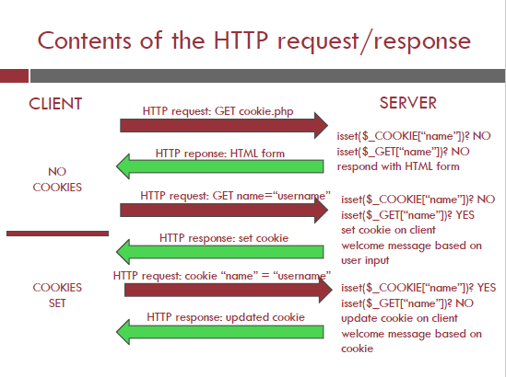

Slide 80
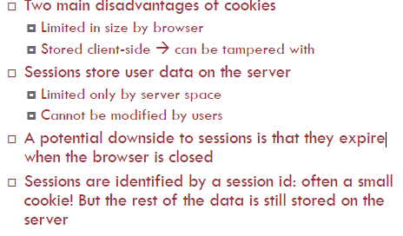
Sessions

Slide 81
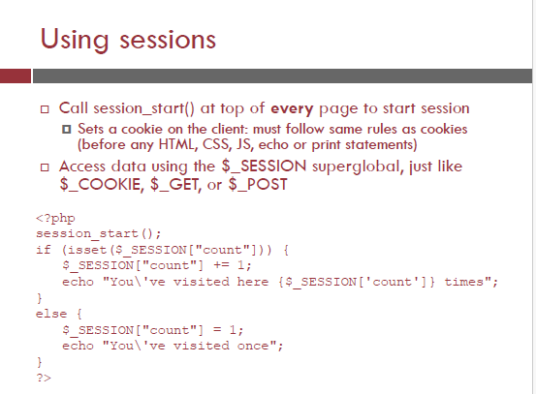

Slide 82
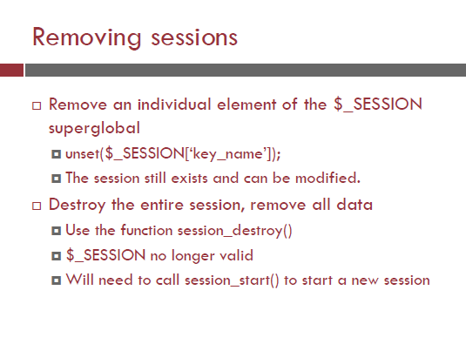

Slide 83
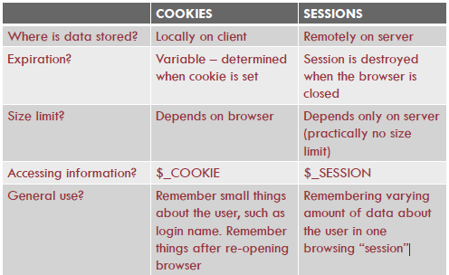

Slide 84
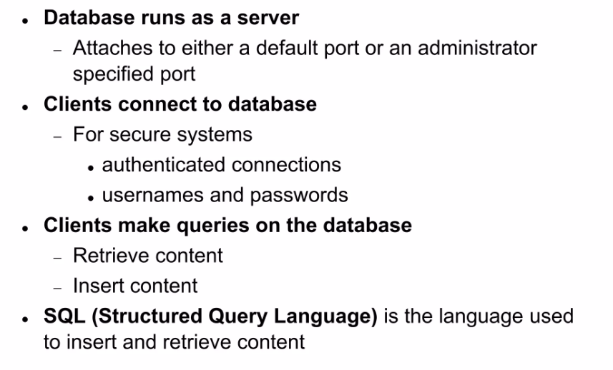
MYSQL Basics

Slide 85
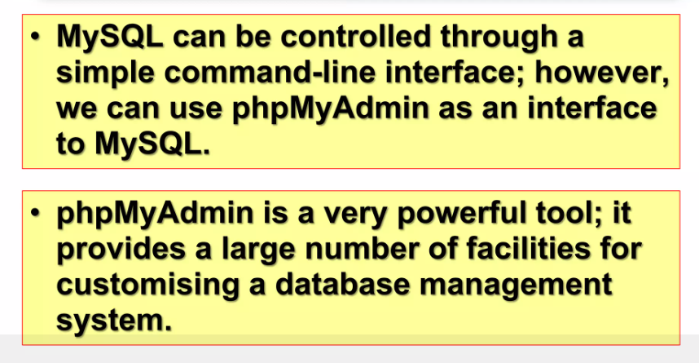
MYSQL Basics

Slide 86
The data in a MySQL database are stored in tables. A table is a collection of related data, and it consists of columns and rows.
Databases are useful for storing information categorically.
With PHP, you can connect to and manipulate databases.
MySQL is the most popular database system used with PHP.

Slide 87
PHP Connect to MySQL
PHP 5 and later can work with a MySQL database using:
MySQLi extension (the "i" stands for improved)
PDO (PHP Data Objects)
Earlier versions of PHP used the MySQL extension. However, this extension was deprecated in 2012.
What should be used MySQLi or PDO?
Anyone can be used. Both MySQLi and PDO have their advantages:
PDO will work on 12 different database systems, whereas MySQLi will only work with MySQL databases.
So, if you have to switch your project to use another database, PDO makes the process easy. You only have to change the connection string and a few queries. With MySQLi, you will need to rewrite the entire code - queries included.
Both are object-oriented, but MySQLi also offers a procedural API.
Both support Prepared Statements. Prepared Statements protect from SQL injection, and are very important for web application security.

Slide 88
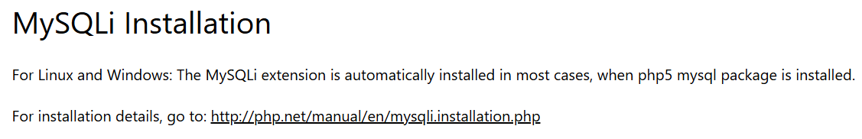


Slide 89
There are three ways of working with PHP and MySQL:
MySQLi (object-oriented)
MySQLi (procedural)
PDO

Slide 90
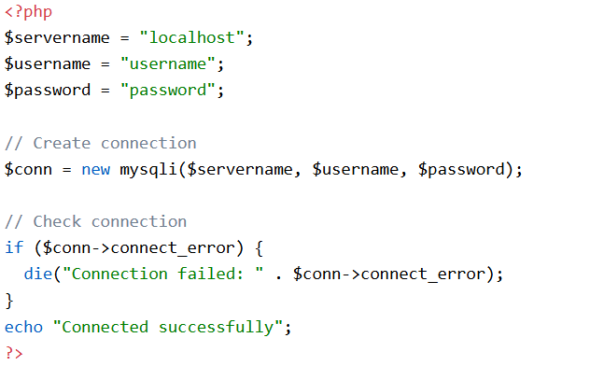
Open a Connection to MySQL
Before we can access data in the MySQL database, we need to be able to connect to the server:
Example (MySQLi Object-Oriented)
die() is a language construct used to terminate the execution of the current script

Slide 91
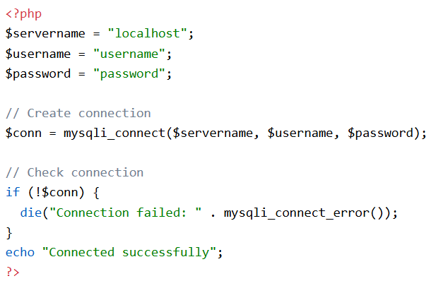
Open a Connection to MySQL
Example (MySQLi Procedural)

Slide 92
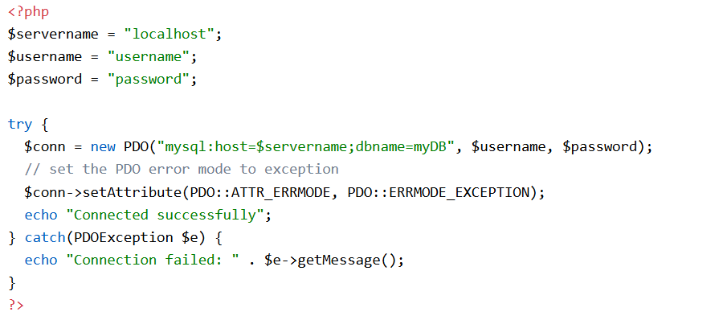
Open a Connection to MySQL
Example (POD)
"mysql:host=$servername;dbname=myDB": Data Source Name (DSN) string.
  mysql → database type.
  host=$servername → server name or IP address.
  dbname=myDB → name of the database to connect to.
$conn: A PDO object that represents the database connection.
catch(PDOException $e): Catches any error thrown during the connection attempt.
getMessage(): Displays the actual error message (e.g., wrong password, database not found).

Slide 93
Open a Connection to MySQL
POD:
In the PDO example we have also specified a database (myDB). PDO require a valid database to connect to. If no database is specified, an exception is thrown.
A great benefit of PDO is that it has an exception class to handle any problems that may occur in our database queries. If an exception is thrown within the try{ } block, the script stops executing and flows directly to the first catch(){ } block.

Slide 94
Close the Connection
The connection will be closed automatically when the script ends. To close the connection before, use the following:
MySQLi Object-Oriented:
$conn->close();
MySQLi Procedural:
mysqli_close($conn);
PDO:
$conn = null;

Slide 95
PHP and XML
What is XML?
The XML language is a way to structure data for sharing across websites.
Several web technologies like RSS Feeds and Podcasts are written in XML.
XML is easy to create. It looks a lot like HTML, except that you make up your own tags.
What is an XML Parser?
To read and update, create and manipulate an XML document, you will need an XML parser.
In PHP there are two major types of XML parsers:
Tree-Based Parsers
Event-Based Parsers

Slide 96
PHP and XML
Tree-Based Parsers
Tree-based parsers holds the entire document in Memory and transforms the XML document into a Tree structure. It analyzes the whole document, and provides access to the Tree elements (DOM).
This type of parser is a better option for smaller XML documents, but not for large XML document as it causes major performance issues.
Example of tree-based parsers:
SimpleXML
DOM

Slide 97
PHP and XML
Event-Based Parsers:
Event-based parsers do not hold the entire document in Memory, instead, they read in one node at a time and allow you to interact with in real time. Once you move onto the next node, the old one is thrown away.
This type of parser is well suited for large XML documents. It parses faster and consumes less memory.
Example of event-based parsers:
XMLReader
XML Expat Parser

Slide 98
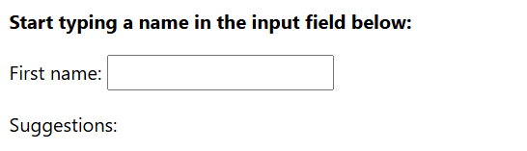
PHP and AJAX
AJAX is used to create more interactive applications.
AJAX PHP Example
The following example will demonstrate how a web page can communicate with a web server while a user type characters in an input field:
Example:
In the example above, when a user types a character in the input field, a function called showHint() is executed.
The function is triggered by the onkeyup event.

Slide 99
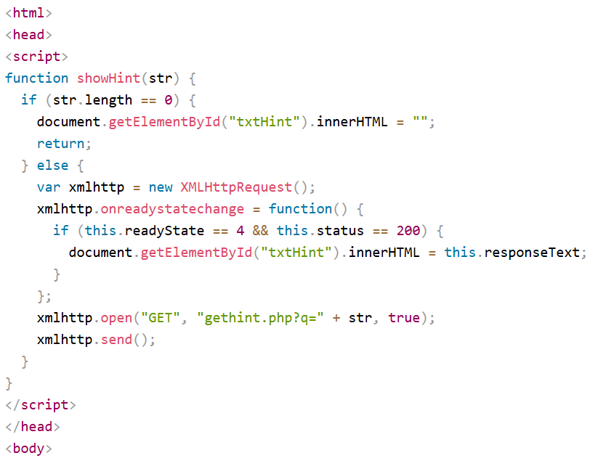
PHP and AJAX
HTML Code:

Slide 100
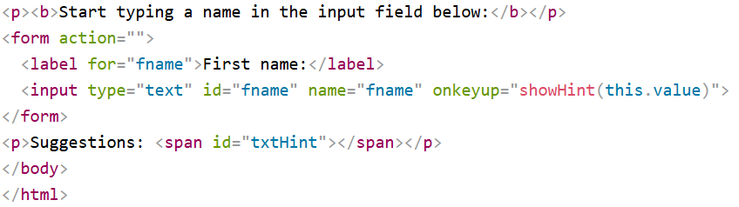
PHP and AJAX
HTML Code:
Code explanation:
First, check if the input field is empty (str.length == 0). If it is, clear the content of the txtHint placeholder and exit the function.
However, if the input field is not empty, do the following:
Create an XMLHttpRequest object
Create the function to be executed when the server response is ready
Send the request off to a PHP file (gethint.php) on the server
Notice that q parameter is added to the url (gethint.php?q=" + str)
And the str variable holds the content of the input field

Slide 101
PHP and AJAX
HTML Code:
Code explanation:
First, check if the input field is empty (str.length == 0). If it is, clear the content of the txtHint placeholder and exit the function.
However, if the input field is not empty, do the following:
Create an XMLHttpRequest object
Create the function to be executed when the server response is ready
Send the request off to a PHP file (gethint.php) on the server
Notice that q parameter is added to the url (gethint.php?q=" + str)
And the str variable holds the content of the input field

Slide 102
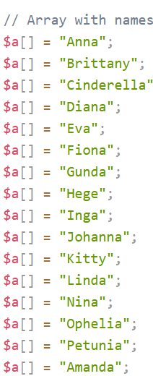
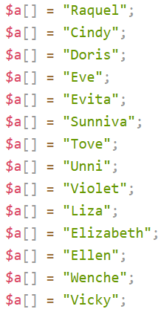
PHP and AJAX
The PHP File - "gethint.php“
The PHP file checks an array of names, and returns the corresponding name(s) to the browser:

Slide 103
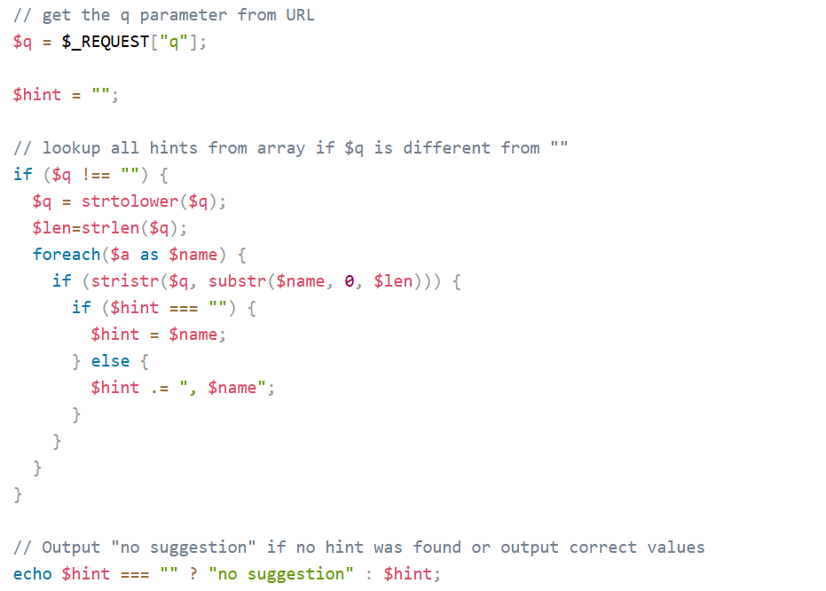
PHP and AJAX

Slide 104
Email and PHP
The mail() function allows you to send emails directly from a script.
Requirements
For the mail functions to be available, PHP requires an installed and working email system.
The program to be used is defined by the configuration settings in the php.ini file.
Installation
The mail functions are part of the PHP core. There is no installation needed to use these functions.

Slide 105
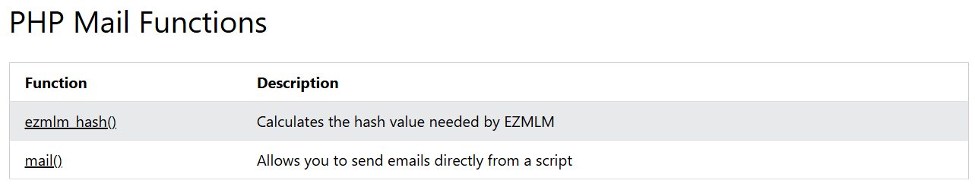
Email and PHP

Slide 106
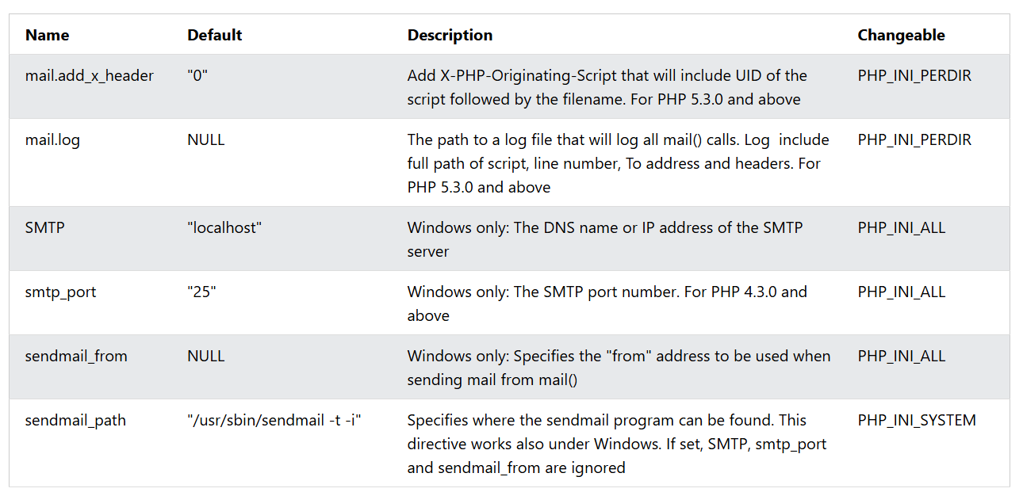
Email and PHP

Slide 107
Questions
1. Demonstrate the need for MySQL. Implement the steps involved to connect MySQL database with PHP in details.
2. Describe the need for PHP session cookies with suitable example.
3. Compare PHP and XML with suitable example. Classify and explain types of XML parsers in details.
4. Demonstrate the need for PHP and AJAX with suitable example.

